Slide 1
TKR COLLEG OF ENGINEERING & TECHNOLOGY DEEP FOREST FIRE DETECTION USING DEEP LEARING
PRESENTED BY: GUIDED BY:
M PRAVEEN KUMAR A SURESH RAO SIR M.TECH PHD
HOD C.S.E
(DEAN OF COLLEGE & VICE PRINCIPLE )

Slide 2
CONTENTS
Introduction
Existing work
Proposed work
Implementation
Results
Conclusion
References

Slide 3
INTRODUCTION
Fire is the big threat in human life like floods, and earthquakes. Situation like fire causes threat to public safety and health. It is the more commonly occurring abnormal event than other abnormal events such as earthquakes and floods. Fire detection system, which are made of hardware, are quite expensive. Hence, researchers proposed image processing and computer vision-based techniques for fire detection. Fire detection using computer vision techniques and image processing has been a topic of interest among the researchers. Indeed, good accuracy of computer vision techniques can outperform traditional models of fire detection. However, with the current advancement of the technologies, such models of computer vision techniques are being replaced by deep learning models such as Convolutional Neural Networks (CNN).

Slide 4
EXISTING WORK
Fire could have the most dynamic features such as area of the flame, randomness of the flame.
Due to this reason, feature extraction using computer vision technique made this process very difficult.
With the enhancement of the technologies, deep learning concept has been introduced.
CNN based deep learning model is the most commonly used model in detection of fire.
Performance of CNN has been found to be quite better as compared to computer vision techniques.
Due to lack of large datasets, sometimes CNN does not give satisfactory results.

Slide 5
PROPOSED WORK
The proposed approach in this paper uses Deep CNN instead of traditional CNN.
Deep CNN is based on the transfer learning that uses pre-trained model to train another model, which is being trained to detect different object.
CNN have been used The models are trained on ‘imagenet’ dataset.
Proposed approach architecture consists of four phases and working of these phases is described in the following sub-sections.

Slide 6
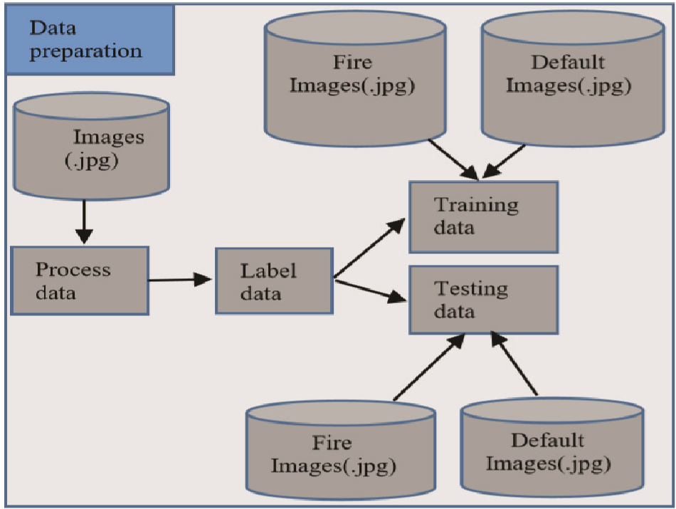
Data Preparation
The data consist for the proposed work consists of images in jpg format. These images are handpicked through various sources over the internet.
After processing, dataset is labelled into training and testing data. Both training and testing datasets are prepared by sampling frames into ‘default’ and ‘fire’ categories. Frames are kept in directories named after the class.

Slide 7
Model creation
The proposed work has been implemented by using Deep convolution neural networks
VGG16 uses sixteen dense layers of neural network This model is created by using convolution layer of different channels with activation function and performing max pooling on these layers.
The final model is created by adding number of ‘Dense’ layers with number of activation units equivalent to number of classes.
Created models act as an input for the training the model along with the datasets.

Slide 8
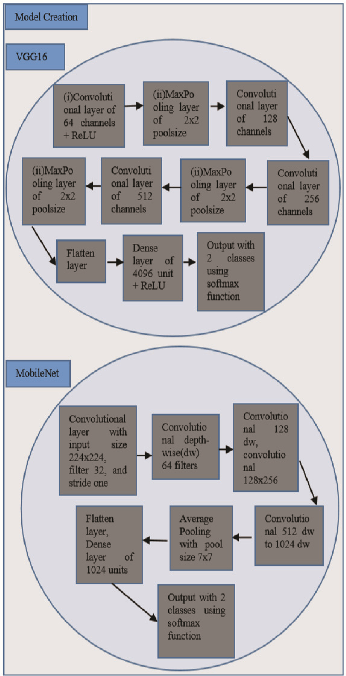

Slide 9
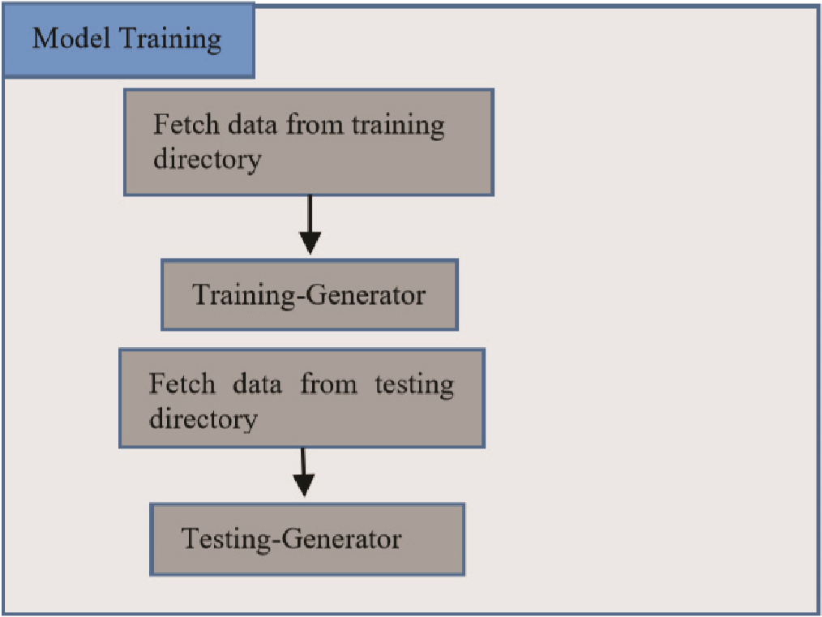
Model Training
To train model data augmentation is done by performing pre-processing function in pre-processing input. The data for training and testing are read from directories using data generator function.
After pre-processing training and testing data, these data send to model fitting for model training.

Slide 10
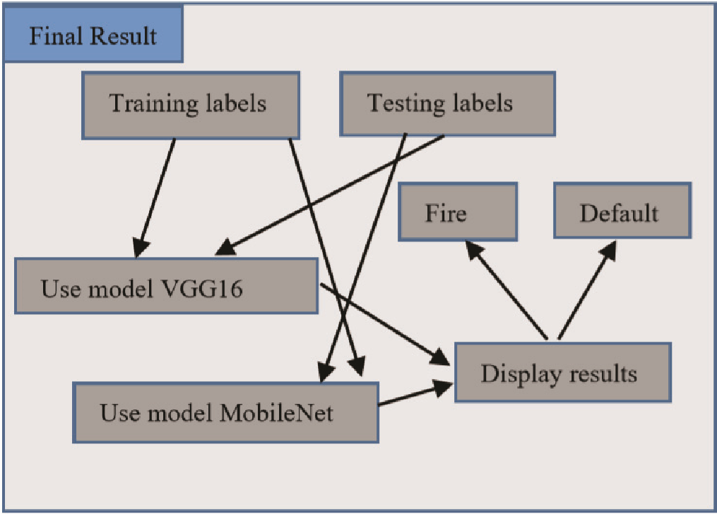
Final Result
Final result shows different graphs of accuracy and loss of training and testing data with epochs (go over training data epoch times and each time update results).
Convolution Neural Network (CNN) model table is drawn as well as Deep Convolution Neural Networks tables.
Final result is tested whether image belongs to fire or non-fire category.

Slide 11
IMPLEMENTATION
VGG16
The architecture of the VGG was introduced by Karen Simonyan and Andrew Zisserman.
It is based on transfer learning which uses deep neural networks to implement.
It is possible to use the learned weight in one model to be transferred in another model with the help of deep neural networks model.
For example, if a model that is used to detect dogs and cats in images can be used in detection of fire and smoke.
VGGNet are classified into VGG16 and VGG19.

Slide 12
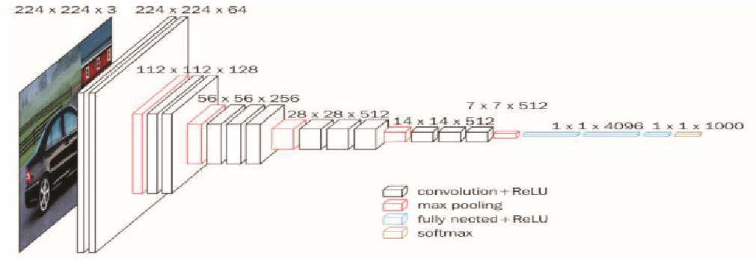
Architecture of VGG16

Slide 13
RESULTS
The performance of fire detection is tested against traditional CNN, and two deep learning models VGG16 and MobileNet using transfer learning to increase accuracy. However, this may also increase training time too.
sample results of CNN model
Epoch | Steps | Loss | Accuracy | Val_loss | Val_acc
1 | 88 | 0.5920 | 0.6922 | 0.7304 | 0.6960
16 | 88 | 0.2505 | 0.9141 | 0.1714 | 0.9284
49 | 88 | 0.2240 | 0.9053 | 0.4713 | 0.9341
50 | 88 | 0.2611 | 0.9112 | 0.3337 | 0.8968

Slide 14
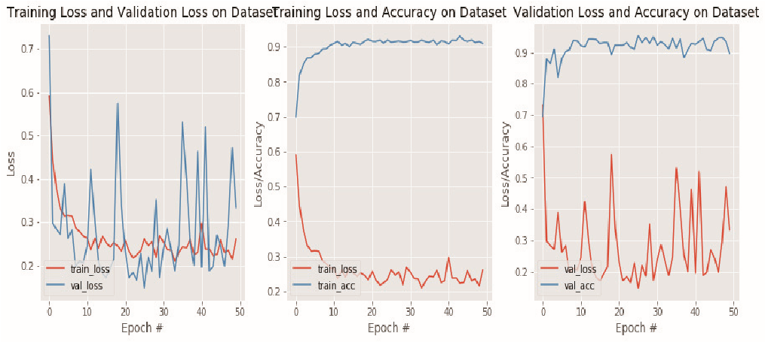
Epoch=50, specifies to go over training data 50 times and each time updates are made and Steps=88, means that how many images are to be processed before making a gradient update. It is calculated by dividing total images to the batch size.
Value of loss function with epochs using CNN

Slide 15
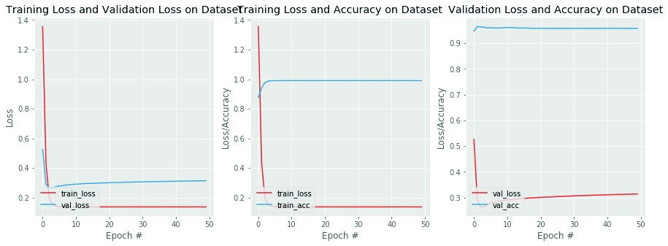
Epoch | Steps | Loss | Accuracy | Val_loss | Val_acc
1 | 88 | 1.3413 | 0.8785 | 0.5258 | 0.9463
25 | 88 | 0.1361 | 0.9915 | 0.3033 | 0.9573
50 | 88 | 0.1360 | 0.9915 | 0.3143 | 0.9573
sample results of VGG16 model
. Value of loss function with epochs using VGG16

Slide 16
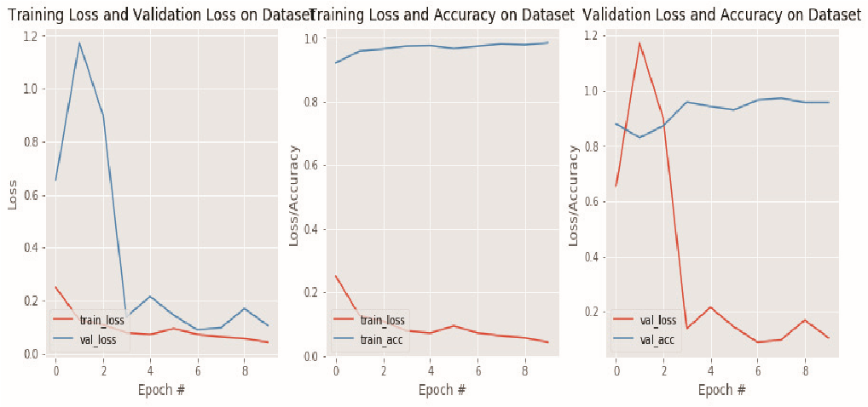
Epoch | Steps | Loss | Accuracy | Val_loss | Val_acc
1 | 88 | 0.2496 | 0.9221 | 0.6546 | 0.8793
4 | 88 | 0.0781 | 0.9745 | 0.1387 | 0.9584
10 | 88 | 0.0424 | 0.9848 | 0.1055 | 0.9570
sample results of MobileNet model
Value of loss function with epochs using MobileNet

Slide 17
CONCLUSION
The proposed work uses both Convolution Neural Networks and Deep CNN using transfer learning for the detection of fire in images.
Convolution Neural Network (CNN) was tested on our dataset and accuracy of training and validation was observed and we have plotted graphs of loss and accuracy in accordance with epochs.
After CNN model we have used Deep CNN models for testing on our dataset and accuracy of Deep CNN models was observed and we have plotted different graphs of loss and accuracy in accordance with the epochs.
We have compared CNN models with VGG model and MobileNet model. Deep CNN uses deep transfer learning approach to train the model that’s why these give better performance.
As we observed in the graph of training versus validation accuracy that Deep neural networks have problem of overfitting the training data. There is still some work that needs to be done.

Slide 18
REFERENCES
R.Bright and R.Custer, “Fire detection: The state of the art,” NBS Technical Note, US Department of Commerce, 1974.
V.Vipin, “ Image processing-based forest fire detection,”International Journal of Emerging Technology and Advanced Engineering, 2.2 (2012), pp. 87-95.
P.V.K. Borges, E. Izquierdo,”A probabilistic approach for visionbased fire detection in videos,” IEEE Trans. Circuits Syst. Video Technol, 20.5 (2010), pp. 721–731.
S. Frizzi, R. Kaabi, M. Bouchouicha, J. M. Ginoux, E. Moreau, and F. Fnaiech, “Convolutional neural network for video fire and smoke detection,”In IECON 2016 42nd Annual Conference of the IEEE Industrial Electronics Society, Oct 2016, pp. 887-882.
S. Hochreiter,J. Schmidhuber, ”LSTM can solve hard long time lag problems,” In Advances in Neural Information Processing Systems; NIPS: San Diego, CA, USA, 1997; pp. 473–479.
S. Kethavath, and M. Dua. "Early Discovery of Disaster Events from Sensor Data Using Fog Computing," International Conference on Intelligent Computing, Information and Control Systems. Springer, Cham, 2019.

Slide 19
THANK YOU

